Slide 1
Online Airline Reservation System
Pingping Ma
Dec 7th, 2006

Slide 2
Overview
Project overview
Database design
Program design
Synchronization issues
User experience
Conclusion

Slide 3
Project Overview
A user may search for a flight between two locations on a specific date.
A user may reserve available tickets.
A user may purchase previously reserved tickets by providing his/her credit card information.
A user may cancel previously reserved tickets.

Slide 4
Project Overview
Three-tier architecture
IDE
  Eclipse, Tomcat and Oracle
Programming languages
  JSP, JavaScript, Servlet, and Javabeans

Slide 5
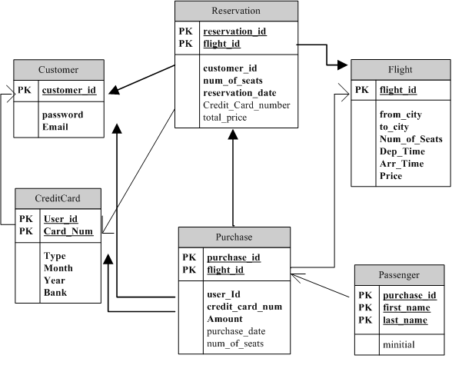
Database Design

Slide 6
Database design
CreditCard is a weak entity dependent upon Customer
Passenger is a weak entity to Purchase
Reservation
  Originally one-way flight
  Later add round trip flights
  One reservation may involve two or more flights.

Slide 7
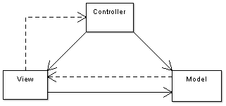
MVC architecture
One of the most popular design patterns of web applications
Example: Struts
Separate UI from business logic
Three components
  Model
  View
  Controller

Slide 8
Program Design
In my program,
  JSP pages act as View
  Java Servlets act as Controller
  Java beans act as Model
    Separate entity beans from action beans
    Entity beans: getter and setter methods
    Action beans: data manipulation and calculation

Slide 9
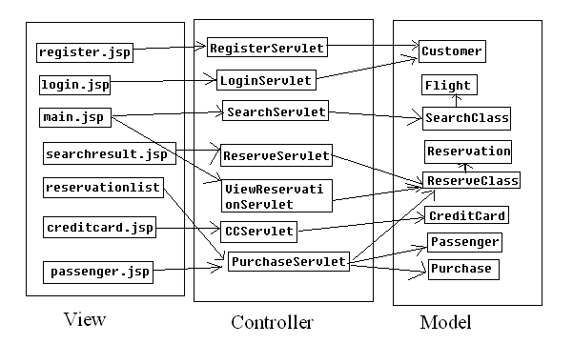
Program Design

Slide 10
Synchronization
Database level
  Oracle: implicit lock automatically
Application level
  Synchronized keyword
  Java’s synchronization model is based on the monitor mechanism. It is used to protect shared resources from simultaneous access and manipulation in a multi-threaded environment

Slide 11
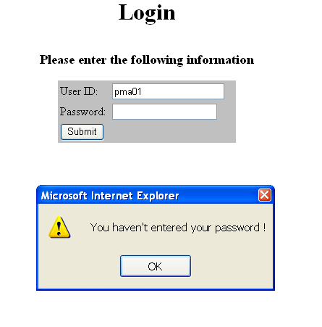
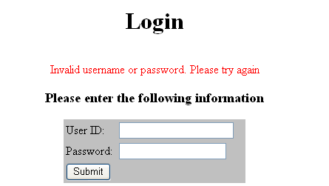
User Experience

Slide 12
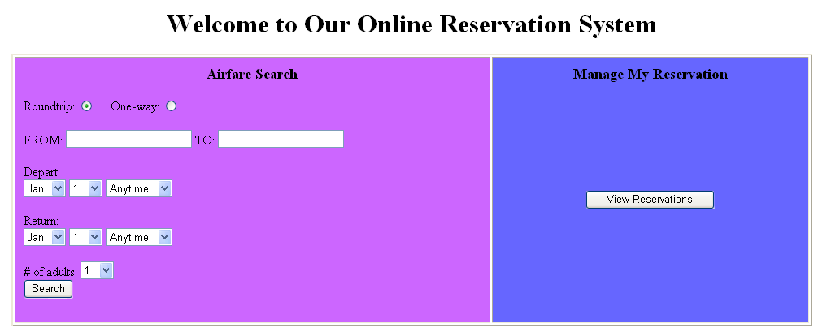
User Experience

Slide 13
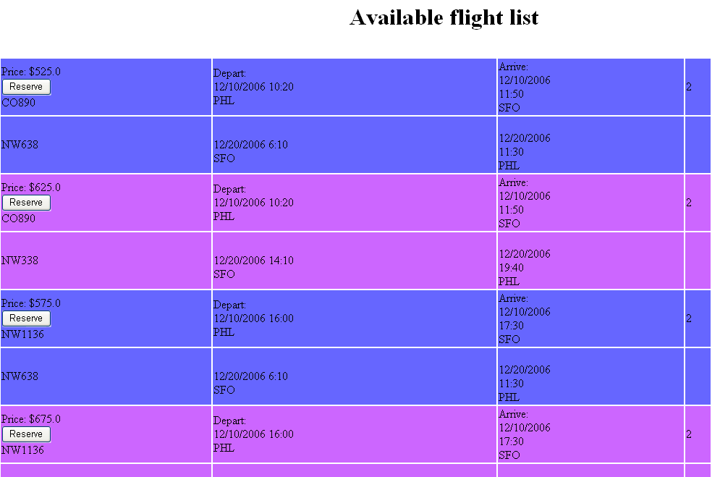
User Experience

Slide 14
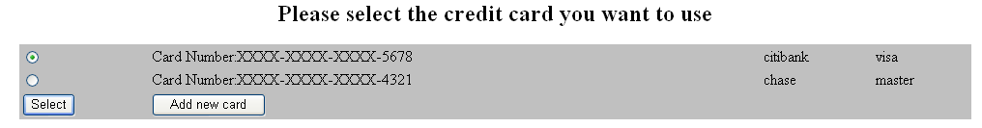
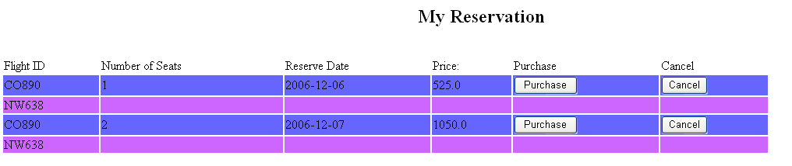
User Experience

Slide 15
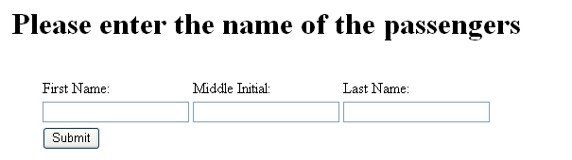
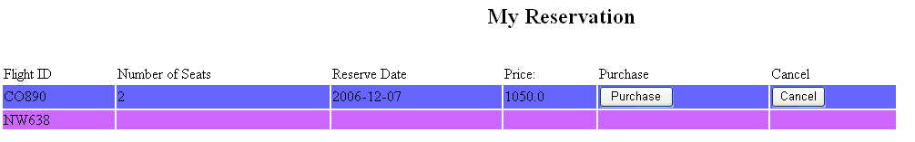
User Experience

Slide 16
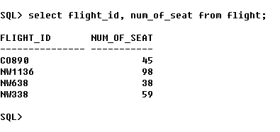
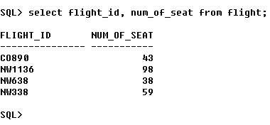
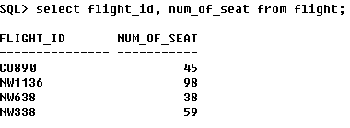
User Experience

Slide 17
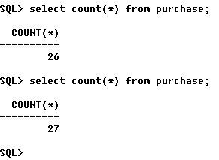
User Experience

Slide 18
Conclusion
Learn a great deal of the J2EE application development
Realize the advantage of the MVC framework
Understand the function of the system fully
Later changes can be costly

